Slide 1
Pacific Cod Stock Dynamics: US and Russian Components
Spawning biomass, exploitation, and climate context
1977–2024

Slide 2
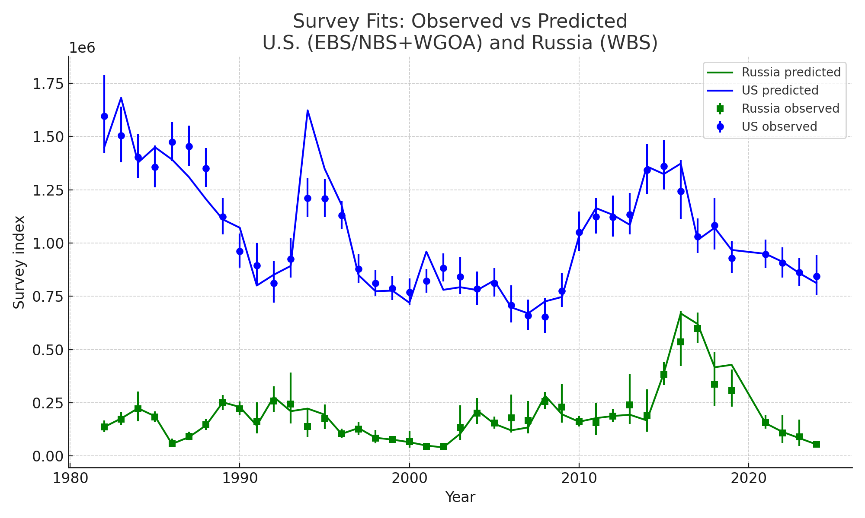
Survey Index Fits (Observed vs Predicted)

Slide 3
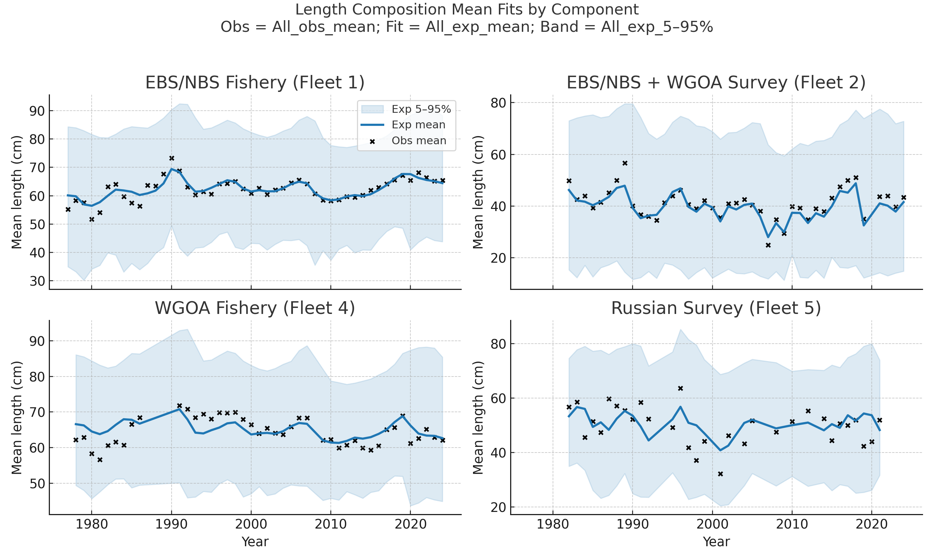
Length Composition Mean Fits by Component

Slide 4
Key Results
US spawning biomass peaked at 0.92 Mt in 1983; declined post-2016
Russian WBS biomass pulse in 2017 (~0.34 Mt, 35% of total)
Russian catches >350 kt (2018–2021); US catches stable ~650 kt
Exploitation peaked near F=1.4 in 2021, driven by WBS
Warm 2010s anomalies aligned with WBS surge

Slide 5
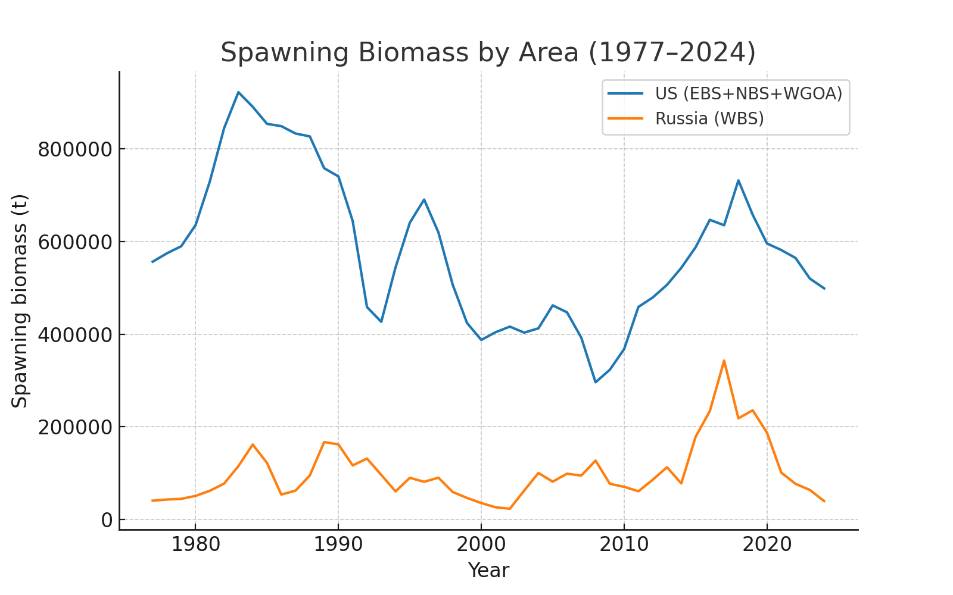
Spawning Biomass by Area (1977–2024)

Slide 6
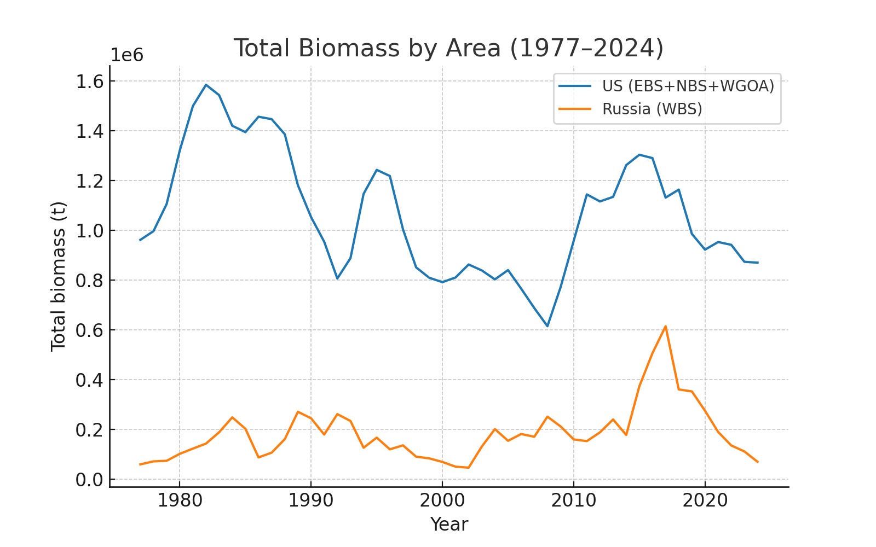
Total Biomass by Area (1977–2024)

Slide 7
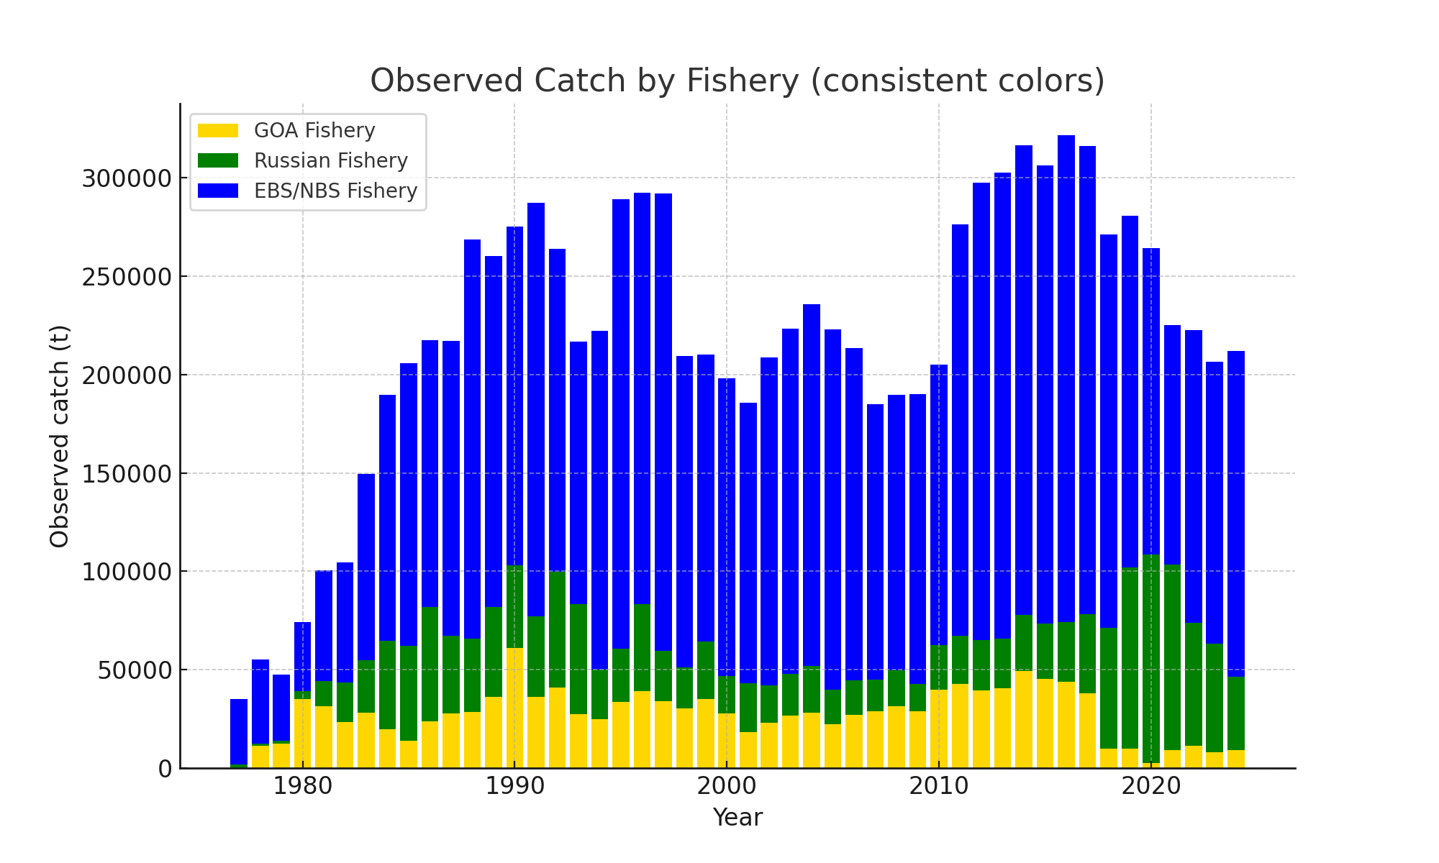
Observed Catch by Fishery

Slide 8
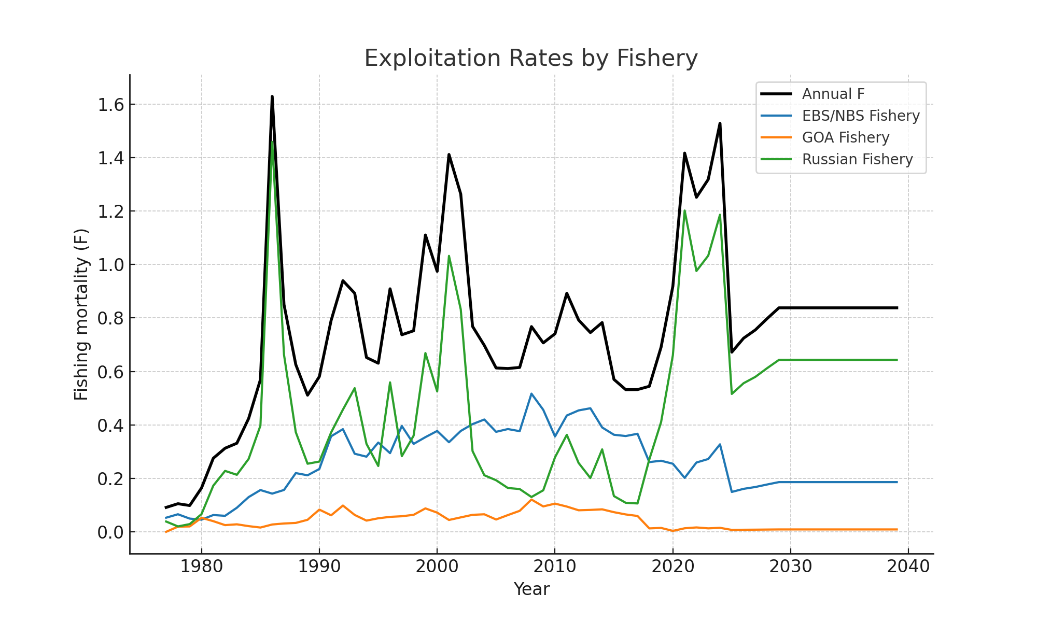
Exploitation Rates by Fishery

Slide 9
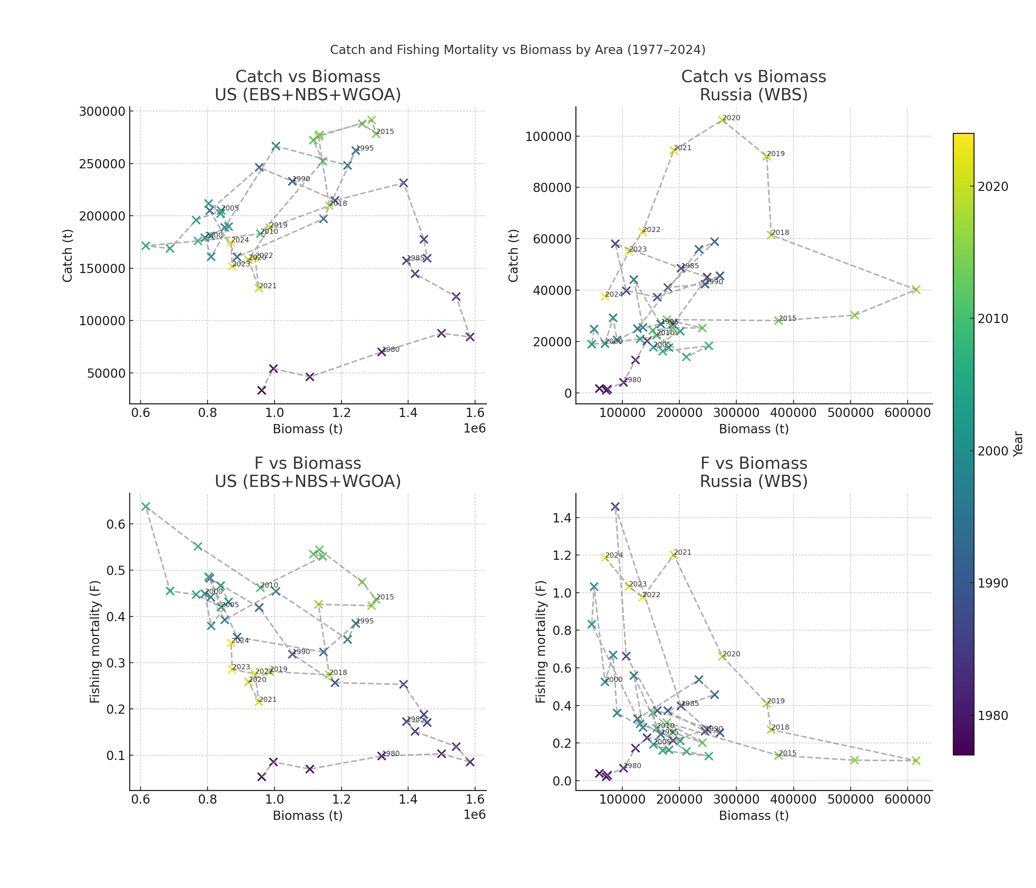
Catch and Fishing Mortality vs Biomass by Area (1977–2024)

Slide 10
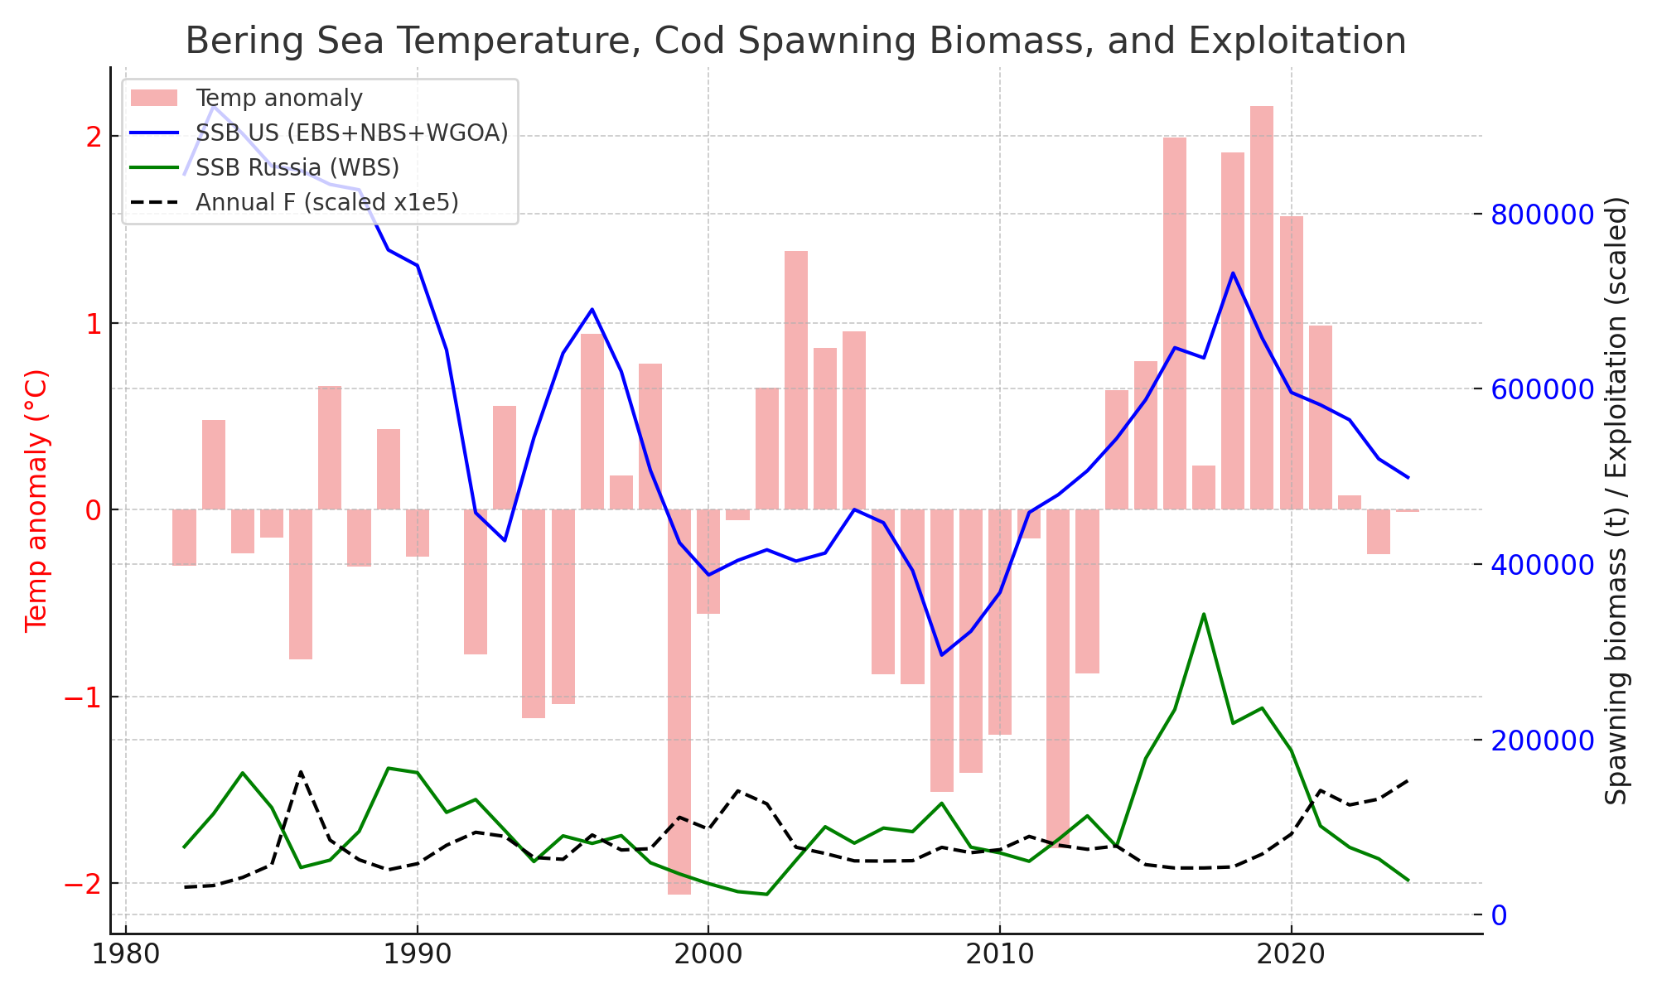
Climate, Biomass, and Exploitation (1977–2024)

Slide 11
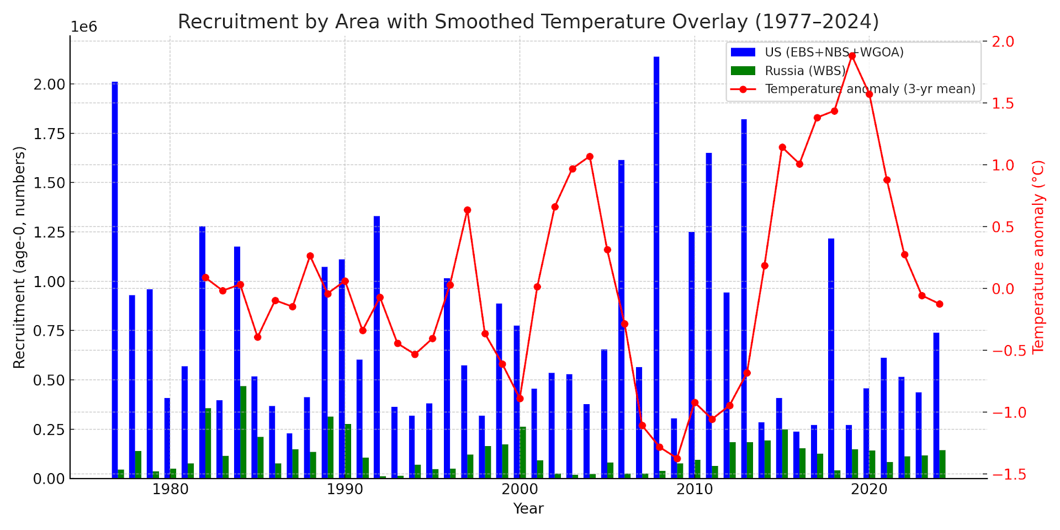
Recruitment by Region with 3-year Smoothed Temperature

Slide 12
Management Implications
Warm-period expansions into Russian waters added major biomass
These pulses were heavily fished by Russian fleets, raising total F
Excluding Russian data underestimates both biomass and removals
Climate variability drives distribution shifts; management must adapt

